Slide 1
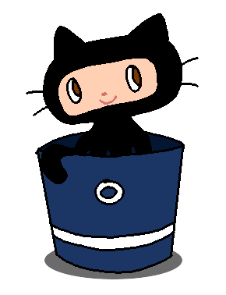
Using Git
CS/IT 490 WD, Fall 2013

Slide 2
Breakdown
What is Source/Version/Revision Control?
Types of Source Control solutions
GitHub and BitBucket
How does Git work?
Basic Git Commands

Slide 3
What is Source/Version/Revision Control?
Source Control is a method for:
  Saving code (and changes to code) to a server periodically
  Easily allowing merges between multiple peoples' changes to one file
  Able to “Diff” to see changes between file “Commits”
  Able to see “Blame” log to see who changed what in a file

Slide 4
What is Source/Version/Revision Control?
Almost all companies that work with software development will be using Source Control.
  Small businesses that aren't software/web oriented may not (i.e., a business with a webpage but not about web; may not realize Source Control exists.)
  Source Control is a must-have tool for developers! It is an important tool!

Slide 5
What is Source/Version/Revision Control?
The Joel Test: 12 Steps to Better Code
http://www.joelonsoftware.com/articles/fog0000000043.html
Do you use source control?
Can you make a build in one step?
Do you make daily builds?
Do you have a bug database?
Do you fix bugs before writing new code?
And so on...

Slide 6
Types of Source Control solutions
Some common source control solutions are...
  TFS (Team Foundation Server) – Microsoft's version control
  SVN (Subversion)
  Hg (Mercurial)
  Git
Mercurial & Git are Distributed Version Control Systems

Slide 7
Types of Source Control solutions
We're not going to get into why you should be using Mercurial or Git instead of SVN.
  (Unless you really really want to)
Each solution has its own nuances and methods for doing things.
If you learn to use Git, using Mercurial and SVN and TFS should be pretty straightforward.

Slide 8
GitHub and BitBucket
GitHub and BitBucket are websites that will host your Source Control repository for you. Code hosting!
You might also be familiar with SourceForge if you download a lot of Open Source software.
CodePlex is Microsoft's source hosting system for Open Source projects.
Google Code is another.

Slide 9
GitHub and BitBucket
GitHub gives you Free Repo Hosting if:
  You're a university student OR
  Your repository is public (Open Source)
If you're going to host private repos without a student email address, you would have to pay GitHub.
GitHub student accounts are only free for a limited amount of time (2 years)

Slide 10
GitHub and BitBucket
GitHub is very active when it comes to Open Source community.
They also have a job posting page.
  Even though I'm not on the job posting page, sometimes recruiters find me via my GitHub projects.

Slide 11
GitHub and BitBucket
BitBucket has free private hosting for teams of up to 5 people – Open Source or not!
You can also host public projects on BitBucket.
BitBucket lets you host Mercurial OR Git projects. GitHub only lets you do Git.

Slide 12
GitHub and BitBucket
Other source hosting websites may let you use something besides Git & Mercurial
  Google Code
  CodePlex
  etc.

Slide 13
GitHub and BitBucket
GitHub and BitBucket hosting have basically the same features in their Web Interface
  Browse the directory from the web
  View code “Diffs” (changes)
  View commit log
  Setup issue log tracking
  Wiki page

Slide 14
How does Git work?
We are not going to cover all of the Git commands, we just need the basics:
  Clone/Init
  Add
  Remove
  Commit
  Status
  Push
  Pull

Slide 15
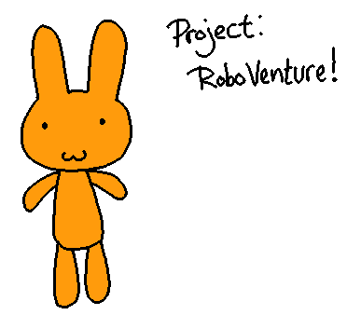
How does Git work?
First, let's assume you're working alone on a project. Source Control is handy whether you're working solo or in a group.

Slide 16
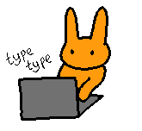
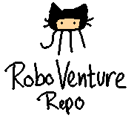
How does Git work?
You create a repository, which you can host on your own server or on a service like GitHub.

Slide 17
How does Git work?
Any time you add new or change existing source files, you add them with the git add command. However, this won't automatically make them show up on the server.
main.cpp
robot.cpp
robot.h

Slide 18

How does Git work?
Instead, adding them is like adding these files to a package. This package will later on be pushed to the server all at once.
main.cpp
robot.cpp
robot.h

Slide 19
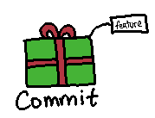
How does Git work?
When you're done adding all the new or changed files, you will use the git commit command to finalize this package. You will be required to give it a label.
main.cpp
robot.cpp
robot.h

Slide 20
How does Git work?
You might commit when you finish working on a small feature or task; “Added robot explosion effect” could be a sample commit message.
The changes made to the files added will be logged.
main.cpp
robot.cpp
robot.h

Slide 21
How does Git work?
Even when you've made a commit, you've merely packaged your changes.
Your files still aren't showing up on the server yet!
main.cpp
robot.cpp
robot.h

Slide 22
How does Git work?
So, when you commit, you've packaged changes that are local to you; they're only on your machine.
To push your changes to the server, you use the git push command.
main.cpp
robot.cpp
robot.h

Slide 23
How does Git work?
Every commit will now be listed under the “commits” section of the webpage, you can look at changes and compare them between different commits.
01: Added robot explosion
02: Refactored input code
03: Added title screen

Slide 24

How does Git work?
You don't have to push immediately after committing. You can create a bunch of commits and then push them all at once.
01: Added robot explosion
02: Refactored input code
03: Added title screen

Slide 25

How does Git work?
You can also go to another machine and pull down all those changes with git pull, enabling you to work anywhere and get the most updated code.
01: Added robot explosion
02: Refactored input code
03: Added title screen

Slide 26
How does Git work?
git add: Adding a file to the commit. This can be a new file, or it can be a file that has changed since the last commit.
git commit: Assign a “commit message” to this package of changes.
git push: Push any commits you have set up to the repository (server).
git pull: You or other teammates can pull the latest code from the server.

Slide 27



How does Git work?
What about working on a team? Multiple people might be changing the same files simultaneously.

Slide 28
How does Git work?
As everybody works, the files they add and commit are local only to their machines. Nothing is affected on anyone else's computers.
Everyone's code is whatever is latest on the server. What is on the server ought to be stable (Commits are good for Work In Progress tasks!)
main.cpp
main.cpp
main.cpp
logger.cpp
npc.cpp
level.cpp
debug.cpp

Slide 29

How does Git work?
After a task is complete, commits are ready to be pushed to the server.
main.cpp
level.cpp

Slide 30
How does Git work?
If someone pushed their updated main.cpp before you did, and you go to push your changes to the server, Git will stop you.
main.cpp
npc.cpp

Slide 31
How does Git work?
You will get a message back saying that the file has been updated, so you need to run git pull and merge your changes with the latest changes before you can push to the server.
main.cpp
npc.cpp

Slide 32
How does Git work?
Generally, merges will happen automatically.
Git might not be able to merge changes if, say, one person deletes a function but another person updates it.
If there is a merge conflict, you have to fix it manually.
main.cpp
main.cpp
npc.cpp

Slide 33
How does Git work?
Once everything is merged, Git will make you create another commit. This commit package is basically just a “these two files were merged”.
main.cpp
npc.cpp

Slide 34
How does Git work?
Afterward, the server will have the latest code and everybody can continue working.

Slide 35
Basic Git Commands
You can also branch your code and merge branches together, but we're not going to get into this.
If you know how to use it, you're free to do so (make sure your team knows how to as well!)

Slide 36
Basic Git Commands
See the “Git Reference” document for a list of commands, and the 2nd practice assignment (which we will do in class).
You can also watch this video walkthru of using Git:
http://www.youtube.com/watch?v=ljgLXhzHeMA

Slide 37
References
-

